Slide 1
HEALTHCARE ANALYTICS PRESENTATION
PRESENTED BY GROUP 2

Slide 2
GROUP MEMBERS
ANIKET DEVRUKHKAR
OSAMA AFTAB
NAZNEEN SIDDIQUA
ANILKUMAR DAGADA
PAVITHRA M V
SHANUF CHOUGULE

Slide 3
KPI LIST
Total Discharge
Patient Days
Net Patient Revenue
Revenue Trend
Patient Stays
State Wise No of hospital /Revenue
Type Of hospital Revenue
MTD/QTD/YTD Revenue
Total Patient, Total Doctor, Total Hospital

Slide 4
SUMMARY
The dashboard provides a snapshot of the overall hospital performance, including patient stays, operational efficiency, financial health and the quality of patient care through different KPIs.
It highlights the incline in the revenue trend. Also, the type of revenues generated by different type of hospitals.
The dashboard compares the bed availability of licensed, staffed and available beds for each type of hospital.
Based on the data, the dashboard offers insights about the different payer sources patients have opted for over the years.
It also highlights the number of hospitals present in each county.

Slide 5
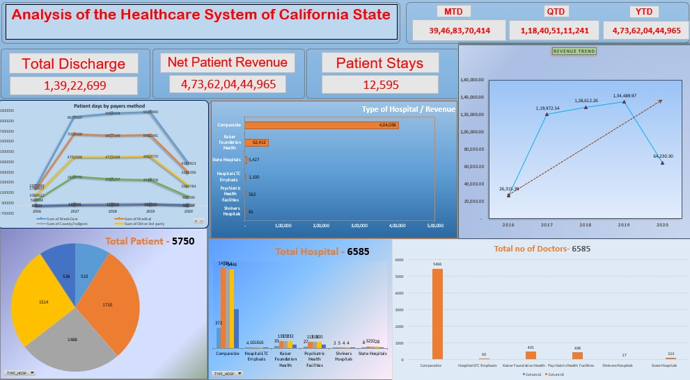
EXCEL DASHBAORD

Slide 6
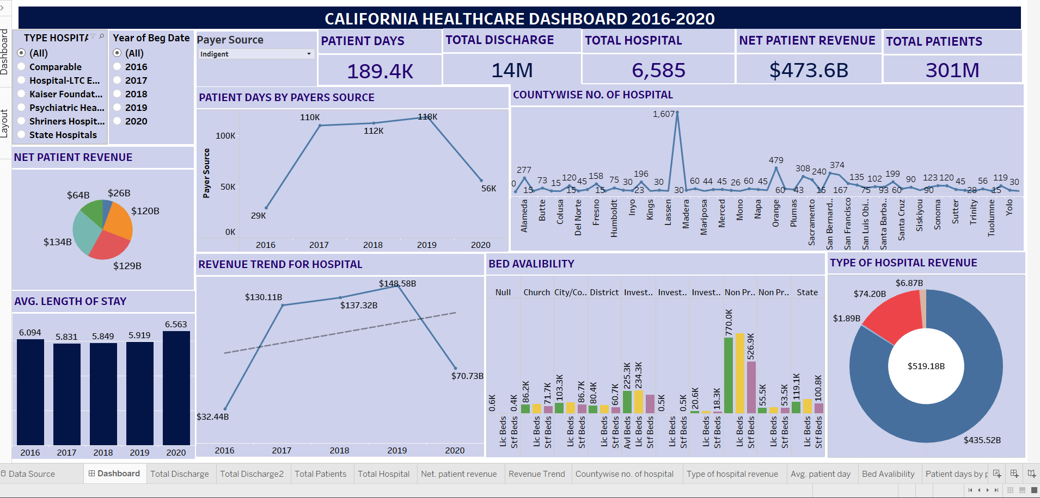
TABLEAU DASHBAORD

Slide 7
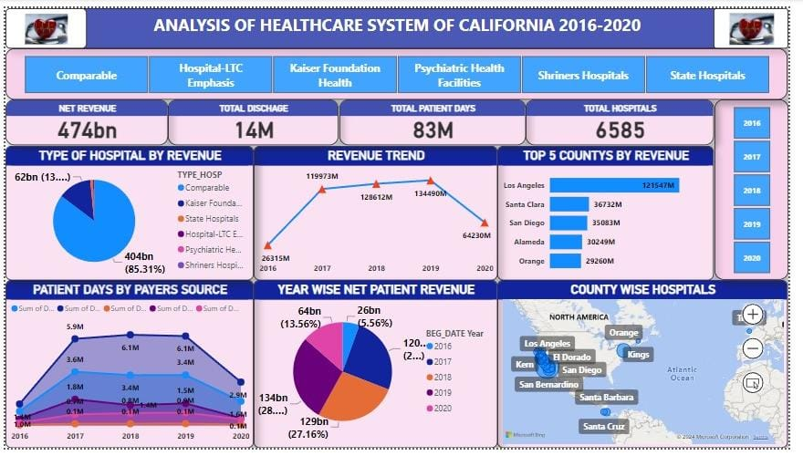
POWER BI DASHBAORD

Slide 8
KEY TAKEAWAYS
The three dashboards provide a comprehensive overview of the healthcare system in California from 2016 to 2020. Here are the key takeaways:
Net Patient Revenue: The net patient revenue over the years has been substantial, reaching $473.6 billion by 2020, with a significant share contributed by various hospital types, notably Comparable hospitals, and Kaiser Foundation Health.
Total Discharge and Patient Days: The total number of patient discharges is consistently high, with 14 million discharges recorded. Additionally, patient days amount to 83 million, indicating a substantial usage of healthcare facilities.
Hospital Types and Revenue: The revenue distribution across different hospital types reveals that Comparable hospitals and Kaiser Foundation Health dominate, contributing the largest share to the overall revenue.
Revenue Trend: Revenue has generally been on an upward trend from 2016 to 2019, peaking at $148.58 billion in 2019 before dropping slightly in 2020 to $137.32 billion. This trend is also mirrored in patient days by payer source.

Slide 9
Hospital and Doctor Count: There are a total of 6,585 hospitals in California, with a similar number of doctors, indicating a well-distributed healthcare workforce.
County-wise and Top 5 Counties by Revenue: Los Angeles leads in revenue contribution among counties, followed by Santa Clara and San Diego. These counties are crucial in the state's healthcare system.
Payer Source Trends: Patient days by payer source show significant variance over the years, with noticeable differences among sources like Medicare, Medi-Cal, and others, which could reflect changes in insurance coverage and healthcare access.
Average Length of Stay: The average length of hospital stay has slightly increased from 2016 (6.09 days) to 2020 (6.563 days), indicating a potential trend towards longer hospital stays over time.
Bed Availability: The dashboards also highlight the availability of licensed and staffed beds across various hospital types, with data showing the distribution across different categories of hospitals.
Top Counties by Revenue: The top 5 counties by revenue are Los Angeles, Santa Clara, San Diego, Alameda, and Orange, emphasizing the significance of these regions in the state's healthcare economy. These takeaways provide insight into the operational and financial aspects of California's healthcare system, showing growth in revenue, patient discharges, and hospital capacity over the observed period.

